Slide 1
BDD Gherkins & Cucumber JUnit
Slides to present the BDD Gherkins implementation with the help of Cucumber JUnit using Java language. This was made possible by adding relevant dependencies to maven POM.XML.
The Java Junit implementation meant:
Gherkin Features file. Scenario followed by Given..When..Then
Java class with the business logic which on this occasion is a calculator
The steps definition java file and the RunTest java class to run JUnit

Slide 2
Feature: Bill Calculator
Scenario: Share a lunch bill
Given We are out for lunch with colleagues
When We received the bill amount
Then The bill amount was shared equally

Slide 3
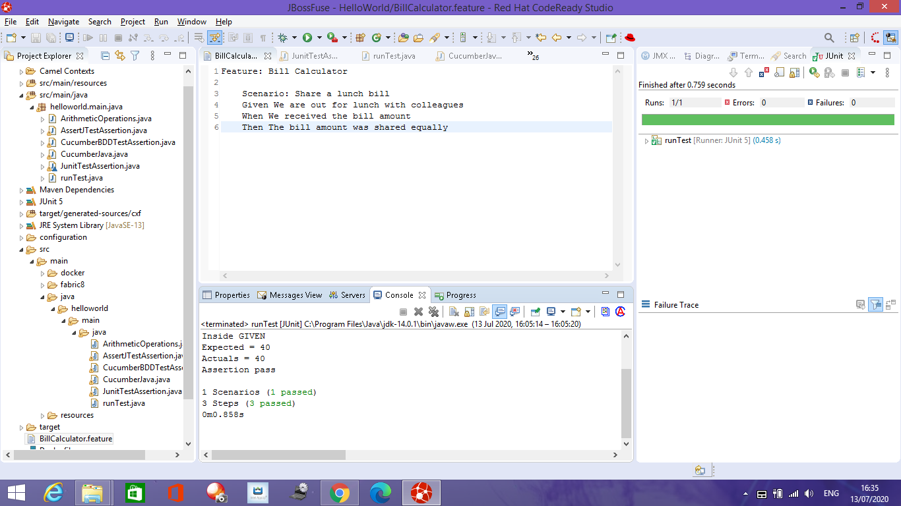
Feature file: BillCalculator.feature

Slide 4
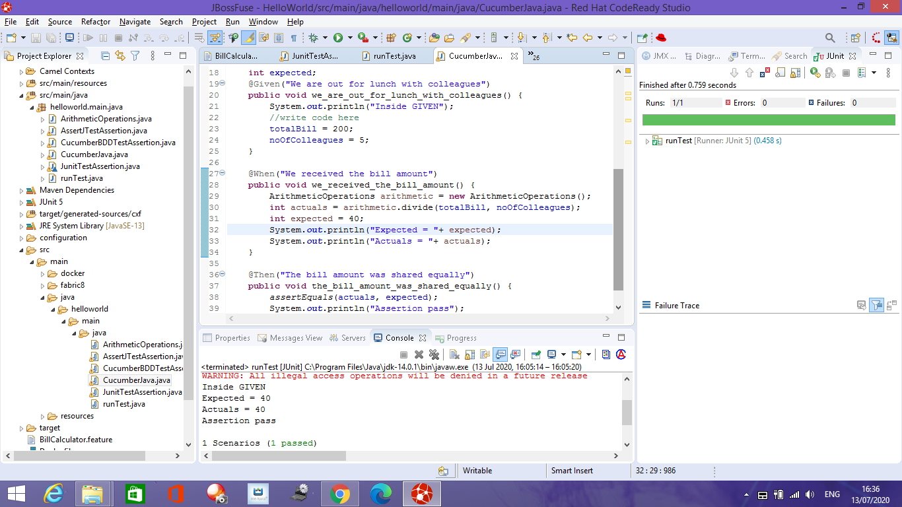
@Given…@When…@Then… java implementation

Slide 5
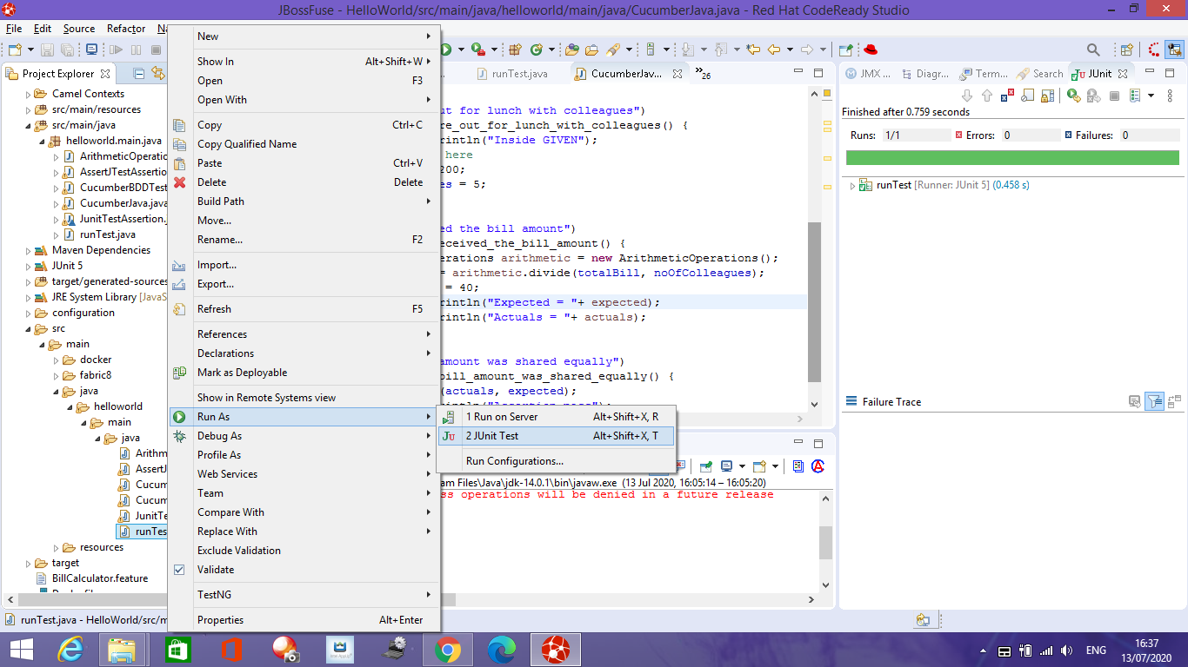
runTest.java with Cucumber class and glue to connect to the implementation steps

Slide 6
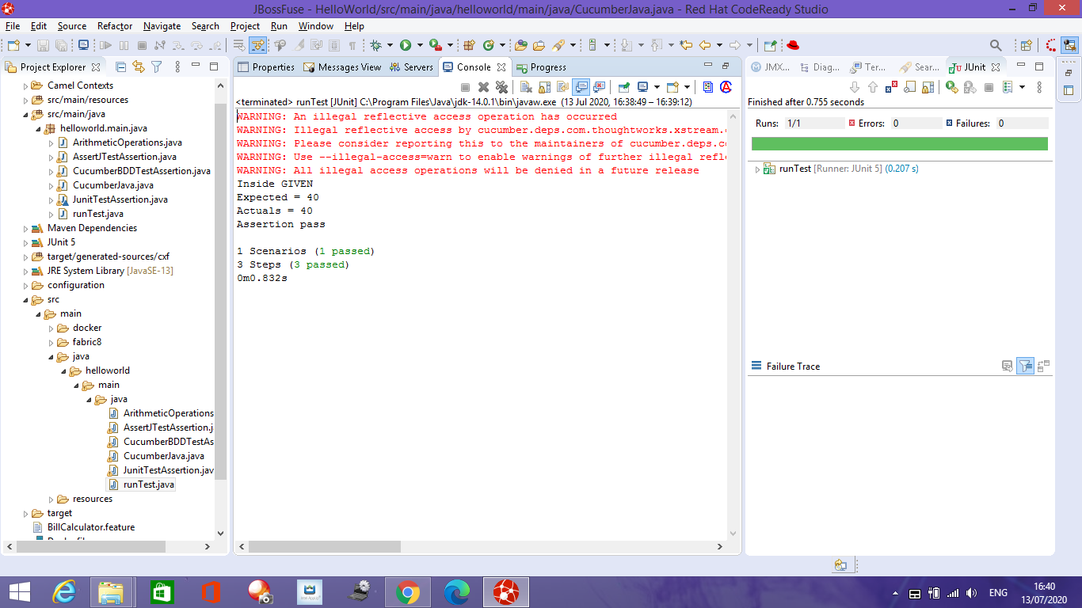
1 scenario passed and 3 steps passed. Cucumber-Junit assertions.

